Slide 1


e-SMP: Interview manager
INTERNATIONAL AGENCY FOR RESEARCH ON CANCER LYON - FRANCE
e-SMP

Slide 2

Introduction
Advantages
The users
Dataflow between GloboDiet & interview manager
Exporting interviews from GloboDiet
Interview manager
  File management
  Interviews management
  Settings
Technical IT issues
IARC, Lyon - France
GloboDiet training:

Slide 3


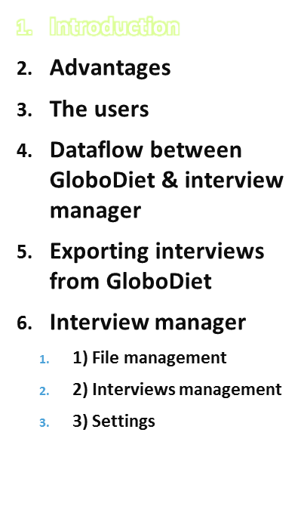
The Interview Manager (IMapp) application allows to manage the collected interview data and to simplify their workflow (e.g. data import & merge, note management, re-compute, exports).
Data are stored within a specific and secure working “environment”
  Secure logical separation of data from different countries even within the same project & within the main IARC site
  In the future, a physical separation will be possible [installing IMapp on specific site levels]
This application allows different user profiles within a project & country (administration module)
  Access to data and actions can be enabled/disabled or limited according to the profile defined for the user
  Ensures security of system and data
  ➔ We have just deployed IMapp so your feedback is very important in order to improve the design and functionalities.
Technical IT issues
IARC, Lyon - France
GloboDiet training:

Slide 4
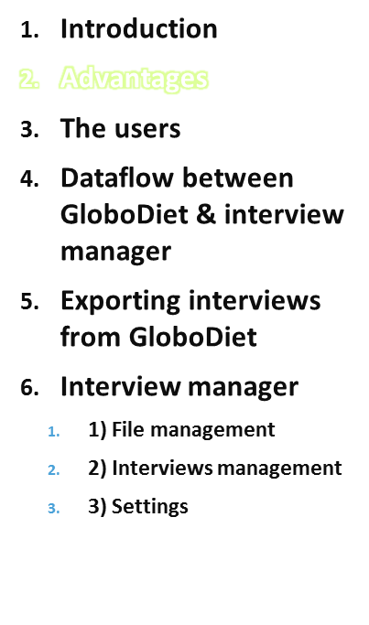
Centralization: Interview Manager allows to:
  Centralize on one server all the interviews done by different dieticians or on different PCs.
  Synchronize and standardize the management of collected interviews (e.g. especially the Notes collected during the interview)
  Control the integrity of the data
  Add a notion of interview “version” after each update.
Communication:
  The use of the Notes allows to simplify the communication between the supervisor (using IMapp) and the persons in charge of the interview updates (using GloboDiet application).
  Each user will be able to view all the reported comments, make modifications to them (e.g. give recommendation on how to quantify an item). The interviews and attached comments are then sent to the interviewers, in order to make the appropriate corrections using GloboDiet application.
Technical IT issues
IARC, Lyon - France
GloboDiet training:

Slide 5
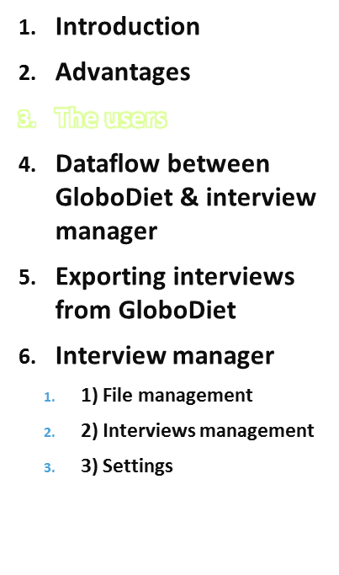
Dieticians/Interviewers in charge of the data collection and the upload in IMapp
Dietician(s) in charge of data management:
  Import all the interview sets into IMapp
  Manage the notes reported during the interviews
  Export interviews that need to be updated using GloboDiet application (e.g. missing quantities).
  Note: this update can also be done by the interviewer who has reported the specific notes. Once the work is done, the corrected interviews can be exported from GloboDiet (as xml-file) and uploaded in IMApp
  Export interviews (as CSV files) for statistical analyses (e.g. for descriptive analyses)
The Country Coordinator(s) who will supervise all the work (e.g. accept to add missing foods in the GloboDiet food list…)
Technical IT issues
IARC, Lyon - France
GloboDiet training:

Slide 6


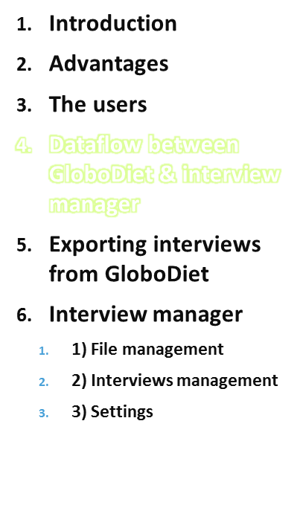




Information to be added in GloboDiet database
(ex: new foods, recipes…)
IMapp
2’
Administration
2
2
1
Preparation of
GloboDiet database
2
4
Interviews/Notes
(raw/updated data)
3
Interviews/Notes
(to be updated)
Data Export for statistical analyses
GloboDiet application
Technical IT issues
IARC, Lyon - France
GloboDiet training:

Slide 7
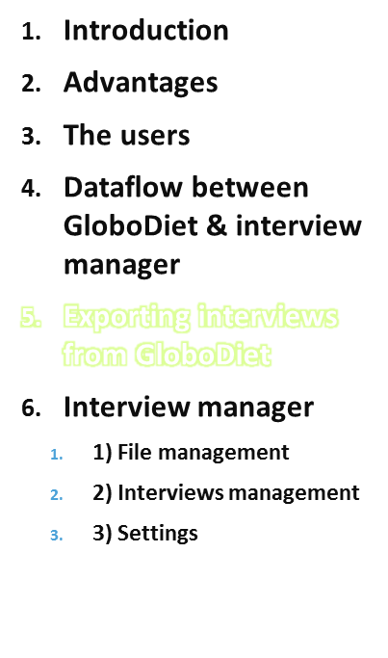
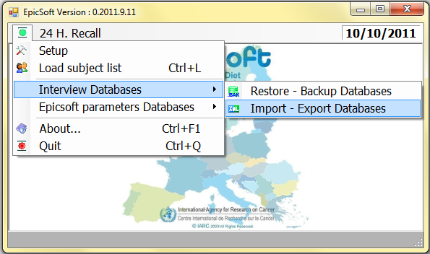
1
Export interviews using the GloboDiet “Interview databases” function in the dropdown menu, then click “Import–Export Databases”
GloboDiet
Technical IT issues
IARC, Lyon - France
GloboDiet training:

Slide 8
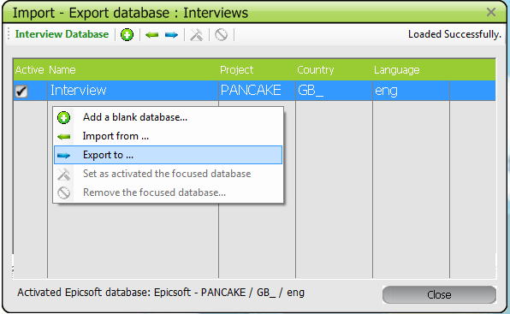
Exporting Interviews from GloboDiet
1
Export the interviews from GloboDiet application
→ confirmation of successful export will be displayed
Technical IT issues
IARC, Lyon - France
GloboDiet training:
Notes:
CC: not needed as it is already in the previous presentation or should be

Slide 9
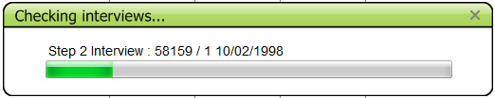
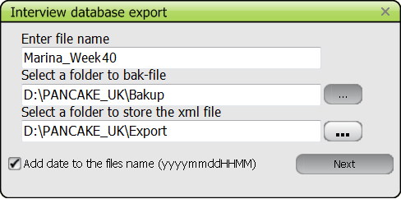
Exporting Interviews from GloboDiet
1
Export the interviews from GloboDiet application
→ confirmation of successful export will be displayed
Technical IT issues
IARC, Lyon - France
GloboDiet training:
Notes:
CC: not needed as it is already in the previous presentation or should be

Slide 10
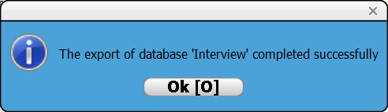
Exporting Interviews from GloboDiet
1
Export the interviews from GloboDiet application
→ confirmation of successful export will be displayed
Technical IT issues
IARC, Lyon - France
GloboDiet training:
Notes:
CC: not needed as it is already in the previous presentation or should be

Slide 11
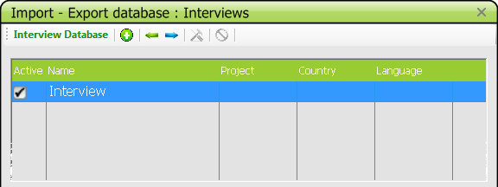
Exporting Interviews from GloboDiet
1
In the selected folders, the following files are generated:
  1 bak-file (e.g. \backup\Marina_Week40_201110101200.bak)
  1 xml-file (e.g. \export\Marina_week10_datehour.xml)
  5 csv-files called Intgi, Notes, Interv, Interv_qt & Intnut.
  (e.g. \backup\Intgi_201110101200.csv)
Exported interviews (xml-file) will no longer be available in GloboDiet after exporting them. An empty interview database will be automatically created in GloboDiet for any subsequent interviews.
Technical IT issues
IARC, Lyon - France
GloboDiet training:

Slide 12
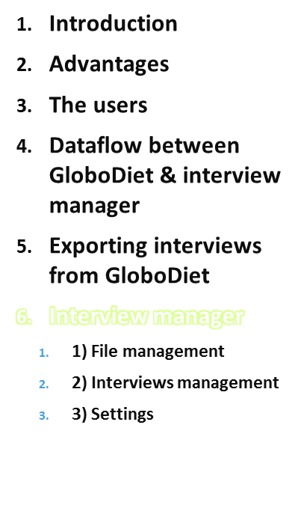
Information to be added in GloboDiet database
(ex: new foods, recipes…)
IMapp
2’
Administration
2
2
1
Preparation of
GloboDiet Tables
2
4
Interviews/Notes
(raw/updated data)
3
Interviews/Notes
(to be updated)
Data Export for statistical analyses
GloboDiet application
Technical IT issues
IARC, Lyon - France
GloboDiet training:

Slide 13
Interview Manager
2
Main available functions are:
  Upload Interview set (by the interviewer)
  Folder Management (*)
  Import Interview sets (*)
  Subject Management
  Note Management (*)
  Display Interviews (*)
  Export selected Interviews (*)
    For update with GloboDiet application
    For data analysis
  Re-compute and check the interviews (on-going)
(*) main dietician(s)/country coordinator(s)
Technical IT issues
IARC, Lyon - France
GloboDiet training:
Notes:
CC: I moved this slide here

Slide 14
Interview Upload in IMapp
2
To upload the exported files (xml-file) in IMapp, the interviewer has to:
  Connect to the IARC platform through a web-browser.
  Access IMapp using personal & secure login name & password,
  Select the attached project/country (& language used for data)
  Upload the set of interviews by using “upload interview” function in the menu
  If a problem occurs during the upload (e.g. not an xml-file), an error message is displayed, and a log-file is generated. Any files with a problem are not uploaded.
Technical IT issues
IARC, Lyon - France
GloboDiet training:
Notes:
CC: for information the point 3: “select the attached project/country & language” → we call that the Perimeter of the data
CC: I moved this slide here

Slide 15
Interview Import
2
After each xml-file import, a log file is generated
If no problem occurred, the log-file just keeps track of the well loaded interviews (by recording the file name, the interview identification as subject code, recall date...)
If a problem occurred, it is described/stored in the log-file.
The main encountered problems can be:
- incompatibility of file formats
- incoherence between the project/country codes of the interview set to be uploaded and the project/country selected upon connecting to IMapp (top of the screen).
Technical IT issues
IARC, Lyon - France
GloboDiet training:
Notes:
CC: I moved this slide here

Slide 16
Note Management
2
3 different types of notes can be reported during the interview (with GloboDiet application):
  General Notes: recorded by the interviewer and directly attached to the subject (e.g. “the subject was impatient”)
  Specific Notes: recorded by the interviewer and attached to a specific item reported (e.g. “I didn’t find the correct quantification method in the proposed ones”)
  Automatic Notes: generated by the system identifying any unexpected cases (e.g. extremes or missing values)
Technical IT issues
IARC, Lyon - France
GloboDiet training:
Notes:
CC: I moved this slide here

Slide 17
Note Management
2
Automatic Notes are directly attached to items such as food, recipe, ingredient or quick list items
Automatic Notes can be:
  Related to missing information, such as:
    “New food”, “New recipe” or “Added/deleted ingredient” in unknown recipe
  Related to controls, such as:
    “Empty quick list item”, “Null or unknown quantity” or “Overflow quantity”
  Warning, such as:
    “Commercial recipe”
Note Status is allocated to each note (e.g. new, ongoing, no adaptation needed, adaptation to be done, done...) and help for workflow and communication
See specific guideline on “Data cleaning protocol”
Technical IT issues
IARC, Lyon - France
GloboDiet training:
Notes:
CC: I moved this slide here

Slide 18
Dataflow between EPIC-Soft & IM
Information to be added in GloboDiet database
(ex: new foods, recipes…)
IMapp
2’
Administration
2
2
1
Preparation of GloboDiet Tables
Interviews/Notes
(raw/updated data)
3
4
Interviews/Notes
(to be updated)
Data Export for statistical analyses
Technical IT issues
IARC, Lyon - France
EPIC-Soft training:
GloboDiet Application

Slide 19

Displaying & Exporting Interviews
3
Interviews that need updating, have to be selected and exported back to the GloboDiet application:
  Export in IMapp generates an xml-file and any exported interviews can no longer be modified in IMapp (flagged as “Exported for update”)
    Reason: An interview cannot be updated in the Interview Manager and in the GloboDiet application at the same time.
  This generated xml-file has to be imported to the GloboDiet application (“interview” – “import” function). The imported interviews should be updated according to the comments available in the notes.
    Note: Before the interview update with GloboDiet application, it may be necessary to first update data of GloboDiet parameter database by adding missing information (e.g. addition of new foods in the food list, new recipes…)
  Once the update is done in GloboDiet, export again: a new set of interviews can be generated (also xml-file) and again uploaded/imported to IMapp. These updated interviews can be accessed in IMapp (use of versioning).
    Note: IMapp keeps track of all the different versions of imported interviews (from “raw interview” version to the one updated last)
3
2’
1
Technical IT issues
IARC, Lyon - France
GloboDiet training:

Slide 20

Displaying & Exporting Interviews
4
Export interviews for data analyses, quality controls…
  This export is usually used for already cleaned data in order to start control & descriptive analyses.
  Export is done in 2 different formats; an xml-file & 5 csv-files (same exported information in both).
  Exported interviews will still be available in IMapp and can be accessed again.
Technical IT issues
IARC, Lyon - France
GloboDiet training:

Slide 21
Dataflow between GloboDiet & IM
Information to be added in GloboDiet database
(ex: new foods, recipes…)
IMapp
2’
Administration
2
2
1
Preparation of
GloboDiet Tables
Interviews/Notes
(raw/updated data)
3
4
Interviews/Notes
(to be updated)
Data Export for statistical analyses
Technical IT issues
IARC, Lyon - France
EPIC-Soft training:
GloboDiet Application

Slide 22
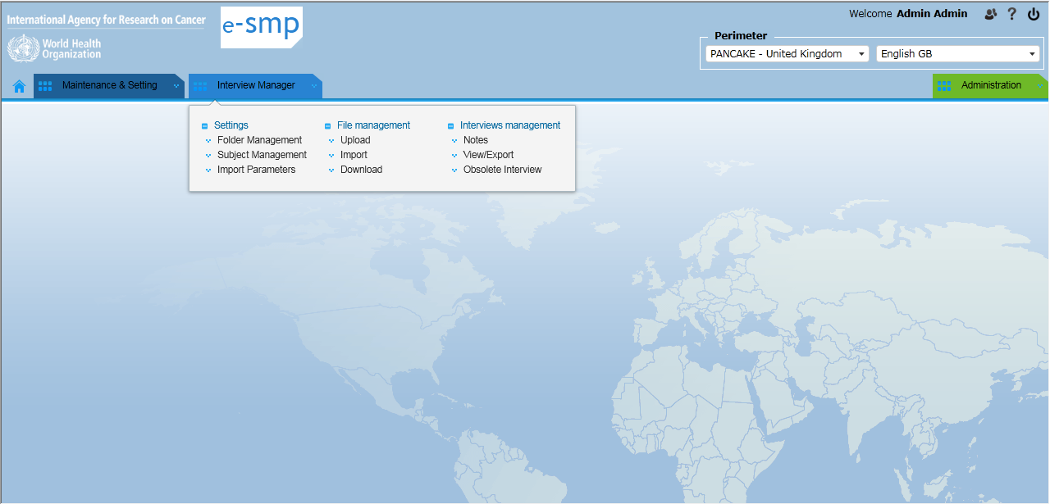
Interview Manager Demonstration
2
Technical IT issues
IARC, Lyon - France
GloboDiet training:
Notes:
From here we can switch to the software demonstration

Slide 23
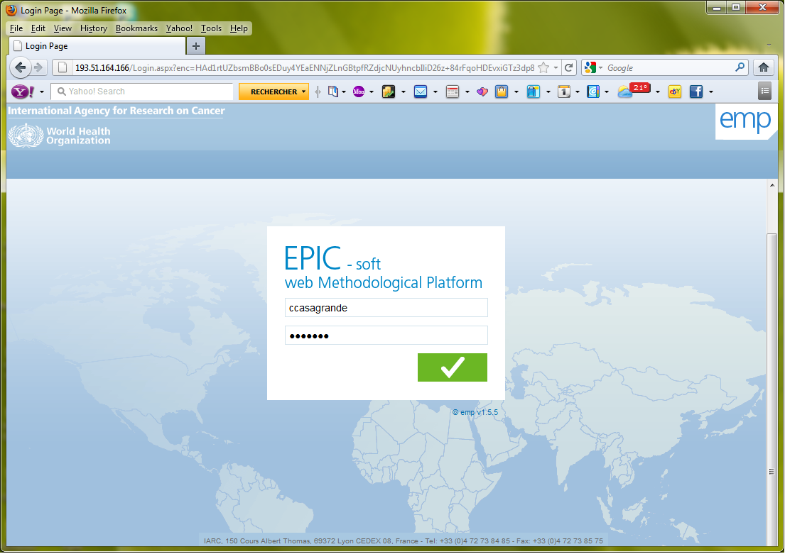
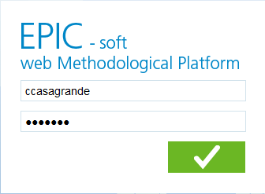
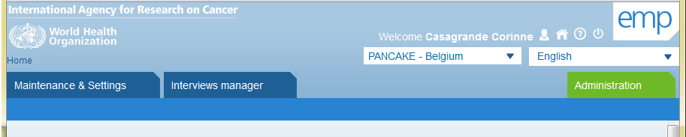
Connecting to IMapp
2
GloboDiet
Web Methodological Platform
Secure & user dependant login
Project/Country and language selection
EPIC-Soft training EMP-PANEU November 7-9, 2011
IARC, Lyon, France <number>
Technical IT issues
IARC, Lyon - France
GloboDiet training:
Notes:
From here we can switch to the software demonstartion

Slide 24
Interview Manager Menu
2
UPLOAD
Technical IT issues
IARC, Lyon - France
GloboDiet training:
Notes:
From here we can switch to the software demonstration

Slide 25
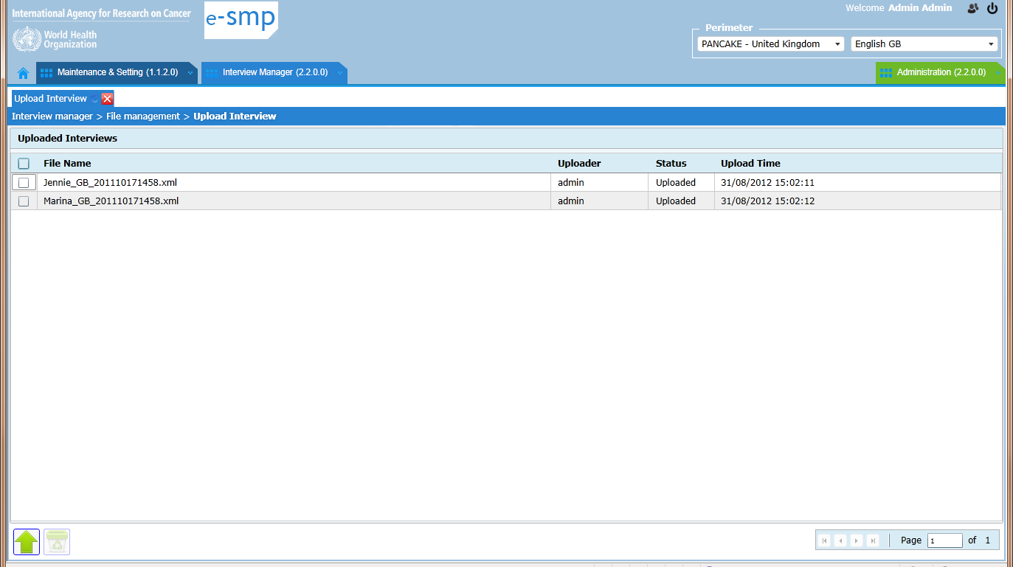
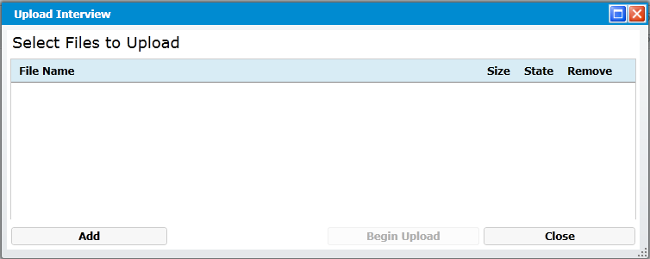
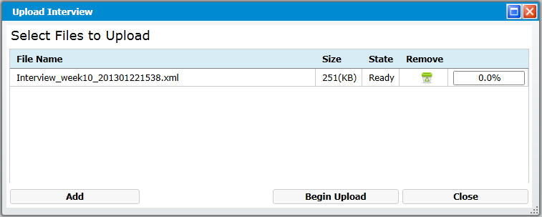
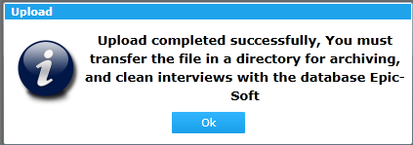
“Upload interview”
2
1. List of uploaded files
Tip: You can upload a zip file containing a number of interviews.
2. Upload button & pop-up
3. Add button to select interview files (XML-file)
4. Begin Upload button to finalize the process or Close button to stop it
5. Upload completed successfully
Technical IT issues
IARC, Lyon - France
GloboDiet training:

Slide 26
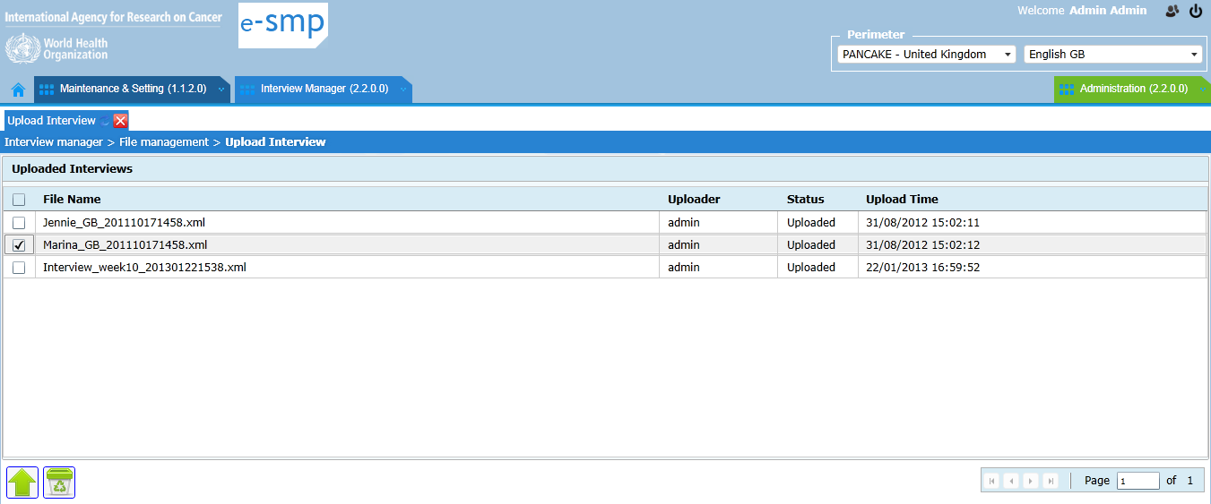
“Upload interview”
2
1. Delete button to remove the selected file(s) from the uploaded file list
Technical IT issues
IARC, Lyon - France
GloboDiet training:

Slide 27
Interview Manager Menu
2
FOLDER MANAGEMENT
Technical IT issues
IARC, Lyon - France
GloboDiet training:
Notes:
From here we can switch to the software demonstration

Slide 28
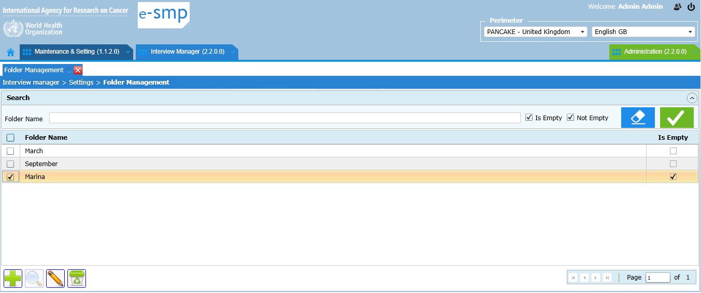
Folder Management
2
Available Functions:
  Create a Folder to classify/file interviews (e.g. by dietician, month, year..)
  Edit a Folder to update its name
  Delete an empty folder
  Move interviews from one folder to another one.
Note: It is not possible to creat a sub-folder (only 1 level)
Technical IT issues
IARC, Lyon - France
GloboDiet training:

Slide 29
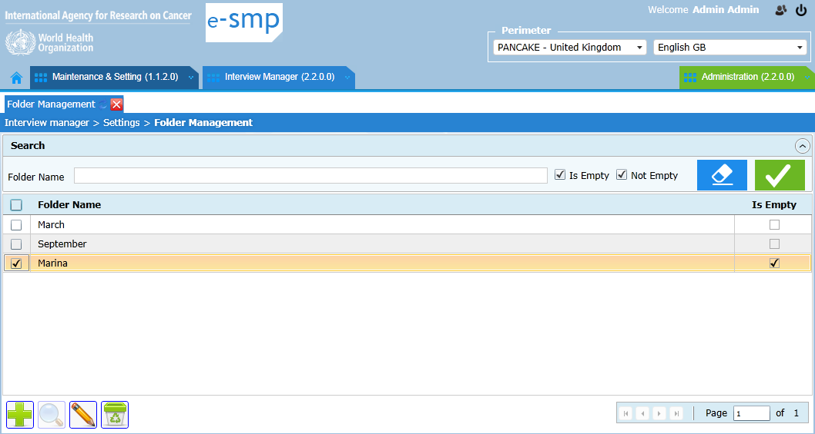

Folder Management
2
Folder search by name (e.g. %Mar% )
Run the search
Erase the search
Move interviews from 1 folder to another one
Edit folder name
Add new folder
Delete empty folder
GloboDiet training:
IARC, Lyon - France
Technical IT issues

Slide 30
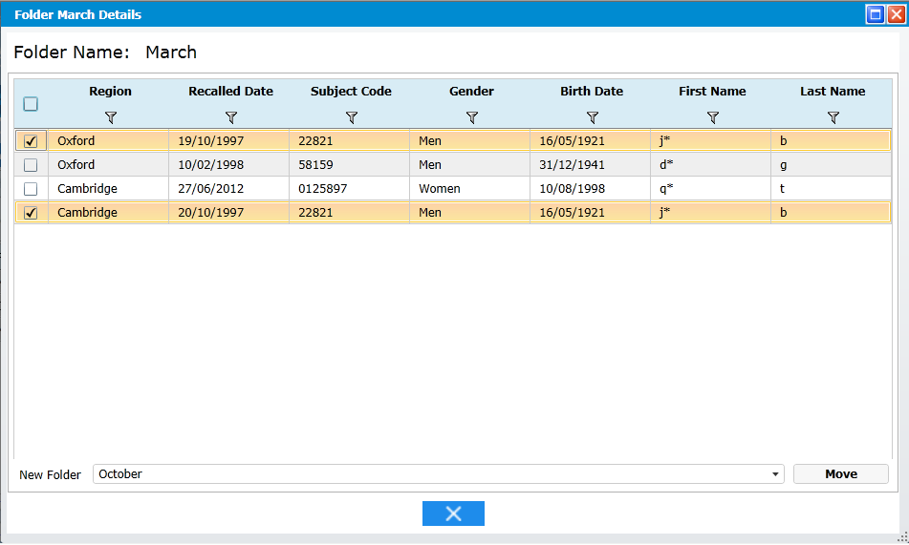
Folder Management
2
Move interview function: List of available interviews within a folder
1. Select interviews to be moved
3. Move Button to re-direct the selected interviews to another Folder
2. Select destination folder
Exit
Technical IT issues
IARC, Lyon - France
GloboDiet training:

Slide 31
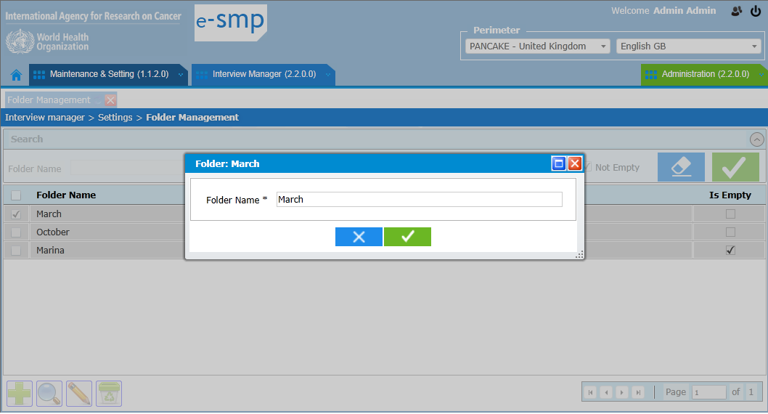
Folder Management
2
Add or Edit a Folder
3. Move Button to move the selected interviews to the new folder
1. Enter or update a folder name
Exit without saving
Save and Exit
Technical IT issues
IARC, Lyon - France
GloboDiet training:

Slide 32
Interview Manager Menu
2
IMPORT
Technical IT issues
IARC, Lyon - France
GloboDiet training:
Notes:
From here we can switch to the software demonstration

Slide 33
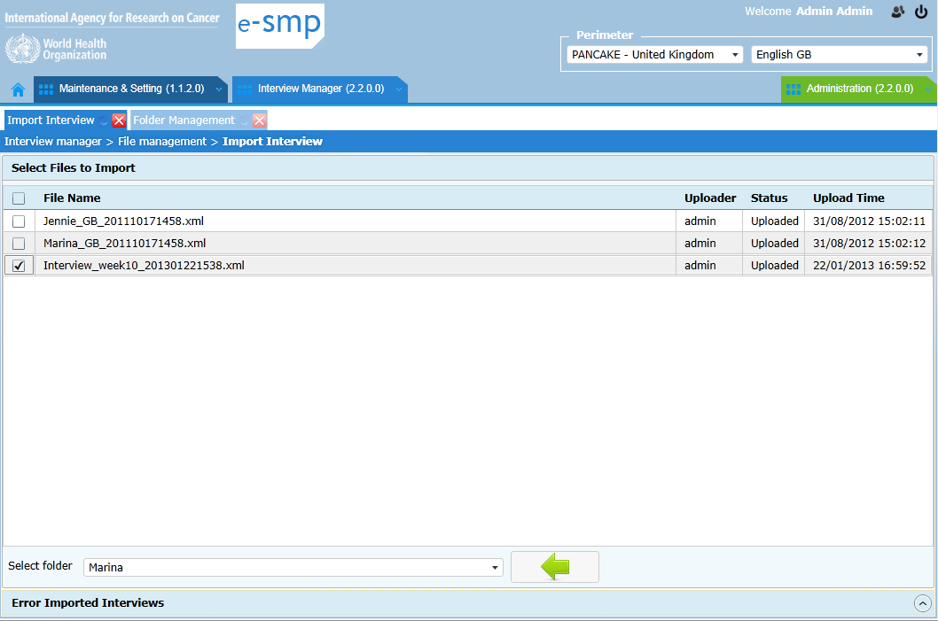
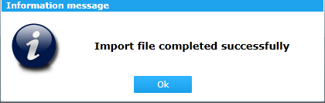
Interview Import
2
1. Select the uploaded interview files to be imported
4. Message of a successful import
3. Import button
2. Folder selection
5. View error messages
Technical IT issues
IARC, Lyon - France
GloboDiet training:

Slide 34
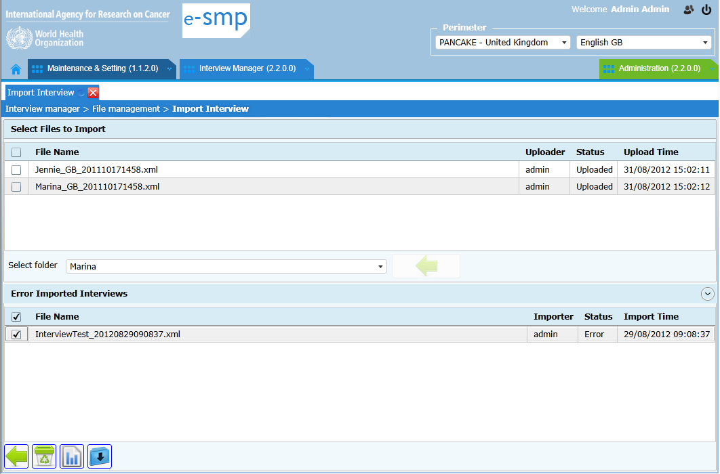
Interview Import: unsuccessfully imported files
2
6. Select the uploaded interview files unsuccessfully imported
Delete selected file
Import button
View error list
Download the selected file on your PC
Technical IT issues
IARC, Lyon - France
GloboDiet training:

Slide 35
Interview Manager Menu
2
SUBJECT MANAGEMENT
Technical IT issues
IARC, Lyon - France
GloboDiet training:
Notes:
From here we can switch to the software demonstration

Slide 36

Subject Management
2
Allocated Functions:
  Edit a selected subject to update his/her general information (e.g. name, sex, birth date...)
  Manage the “Temporary” subject
  After the interview import, some subjects in the list can be defined as “Temporary”. This means that another subject with the same code already exists but has been assigned a different sex/gender or birthdate values.
  As there is a problem of identification, you have to modify the wrong value(s) using the Edit function changing the incorrect values (either for the temporary subject or its counterpart with the same subject code).
Technical IT issues
IARC, Lyon - France
GloboDiet training:

Slide 37
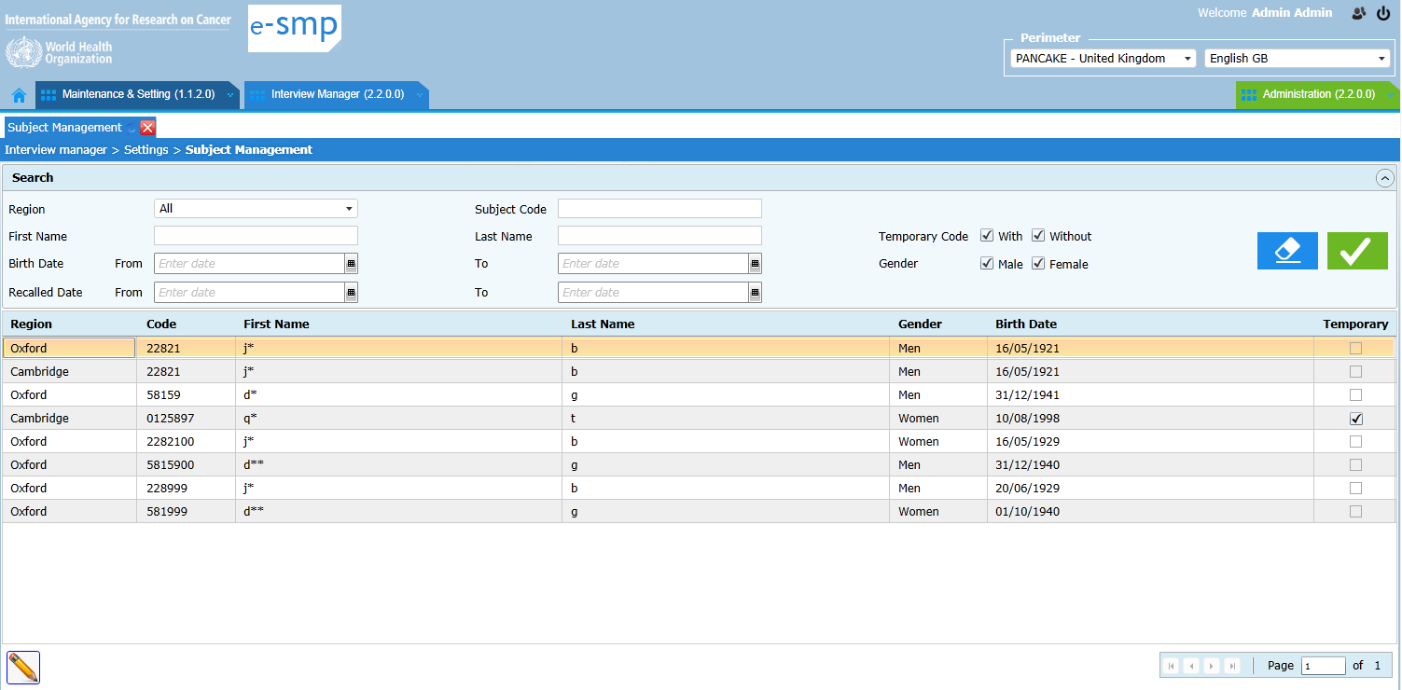
Subject Management
2
Subject with identification problem (to be reviewed/corrected)
Technical IT issues
IARC, Lyon - France
GloboDiet training:

Slide 38
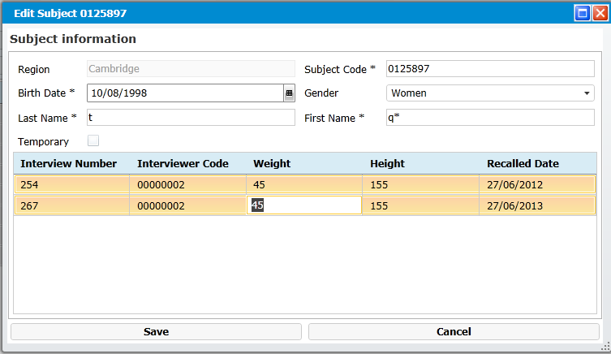
Subject Management: Edit
2
Technical IT issues
IARC, Lyon - France
GloboDiey training:

Slide 39
Interview Manager Menu
2
NOTES
Technical IT issues
IARC, Lyon - France
GloboDiet training:
Notes:
From here we can switch to the software demonstration

Slide 40
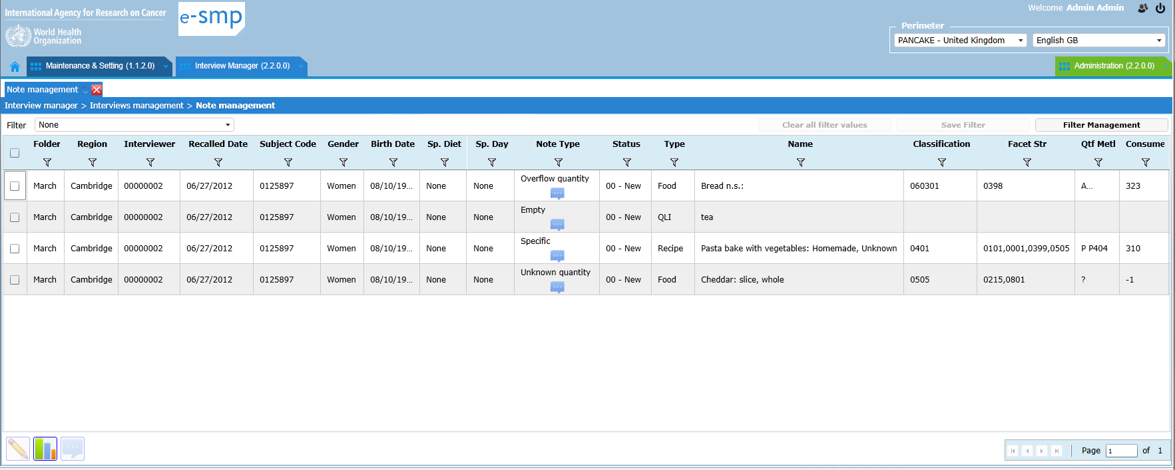
Note Management
2
All the reported notes are listed in the imported interviews
Technical IT issues
IARC, Lyon - France
GloboDiet training:

Slide 41



Note Management
2
Allocated Functions:
  Filter, available in each column to refine the search
    → Possibility to save a defined Filter, to open an existing one, to manage the available ones and to clear all
  Edit a note to change its status & comments
  Update of several notes together: allows to change the statuses and/or to add comments to selected notes at the same time
  → See specific guideline on “Data cleaning protocol”
  Export the interviews that have notes listed on screen for information (CSV- and XML-files)
Technical IT issues
IARC, Lyon - France
GloboDiet training:

Slide 42
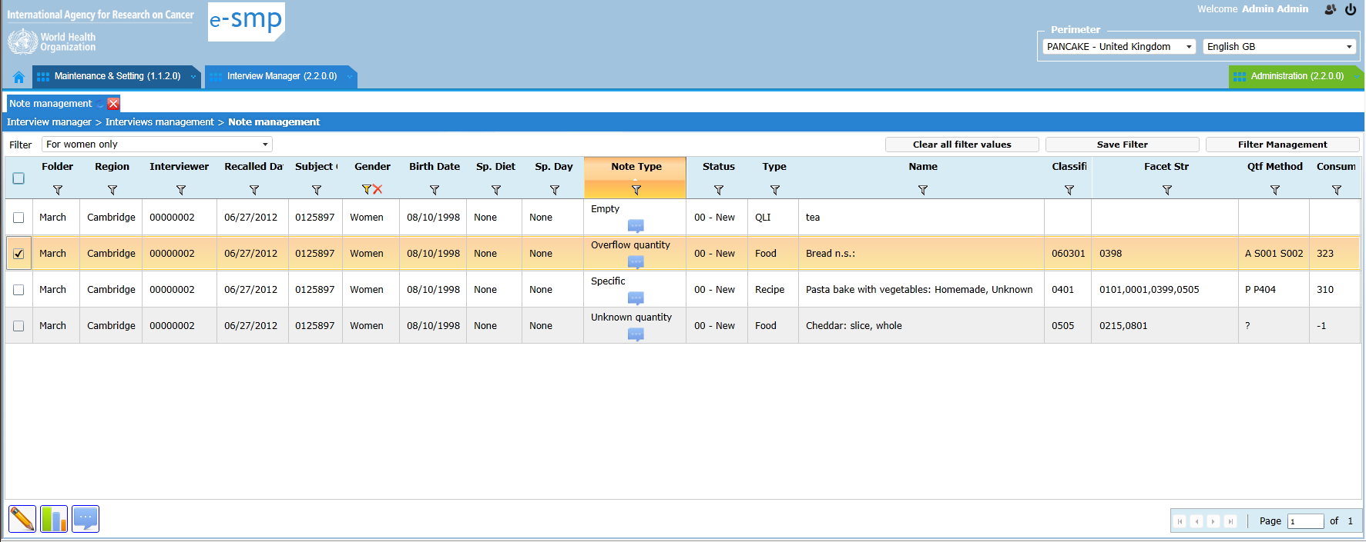
Note Management
2
Select a pre-defined filter
Clear all filters
Save a defined filter
Filter management
Enter a filter condition
-- Unknown Quantity --
-- Overflow Quantity --
Update of several note statuses & comments together
Edit a selected note
status & comment
Export interviews that have notes listed on the screen
Technical IT issues
IARC, Lyon - France
GloboDiet training:

Slide 43
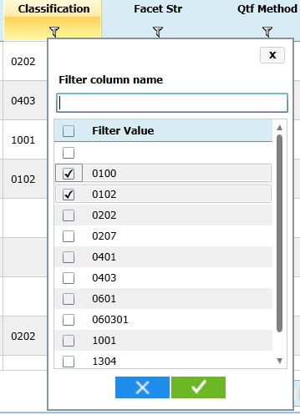
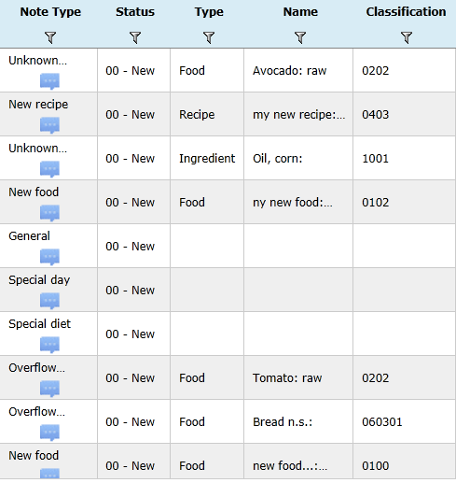
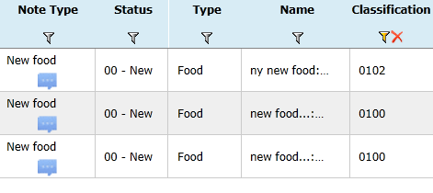
Note Management: search
2
Search function using funnel(s)
Click on a funnel to filter
Click on the red cross to delete the filter condition
Technical IT issues
IARC, Lyon - France
GloboDiet training:

Slide 44
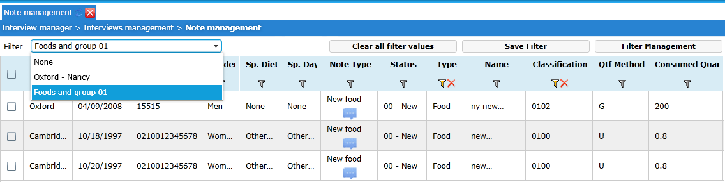
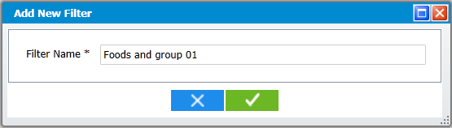
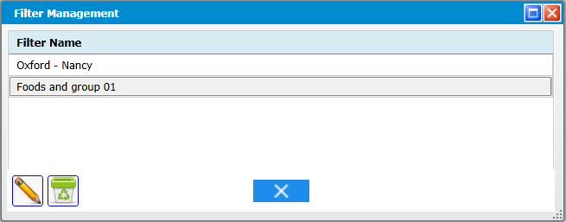
Note Management: Filter Management
2
Select a pre-defined filter
Clear ALL the existing filters
To edit or delete a selected filter
Technical IT issues
IARC, Lyon - France
GloboDiet training:

Slide 45

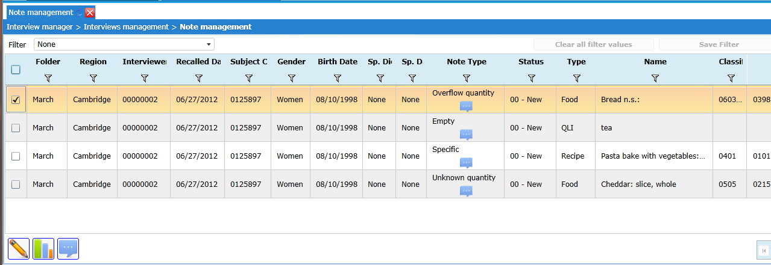
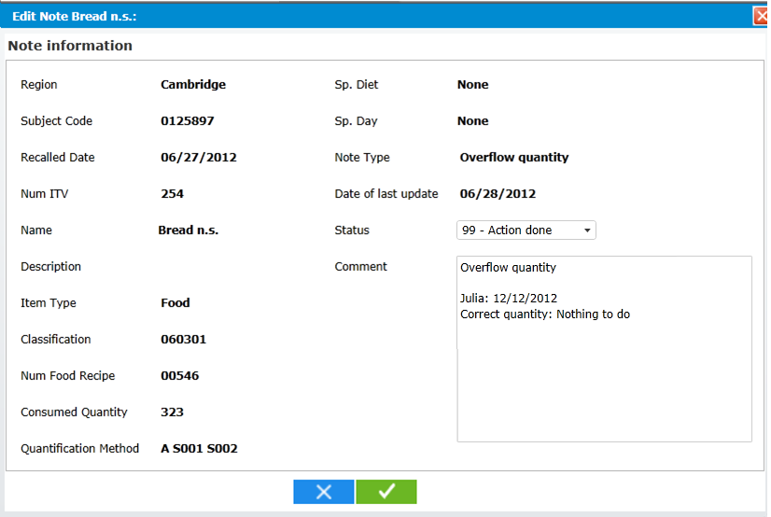
Note Management: Edit
2
Editing a selected Note
Change the note’s status
Add a comment
Technical IT issues
IARC, Lyon - France
GloboDiet training:

Slide 46

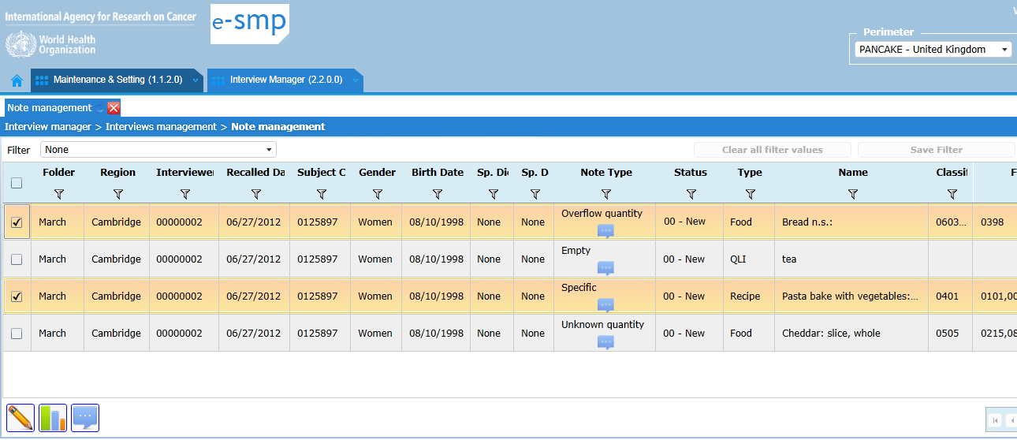
Note Management: Update
2
Updating several notes at the same time
Select several items to be updated
Update status & comments
Technical IT issues
IARC, Lyon - France
GloboDiet training:

Slide 47
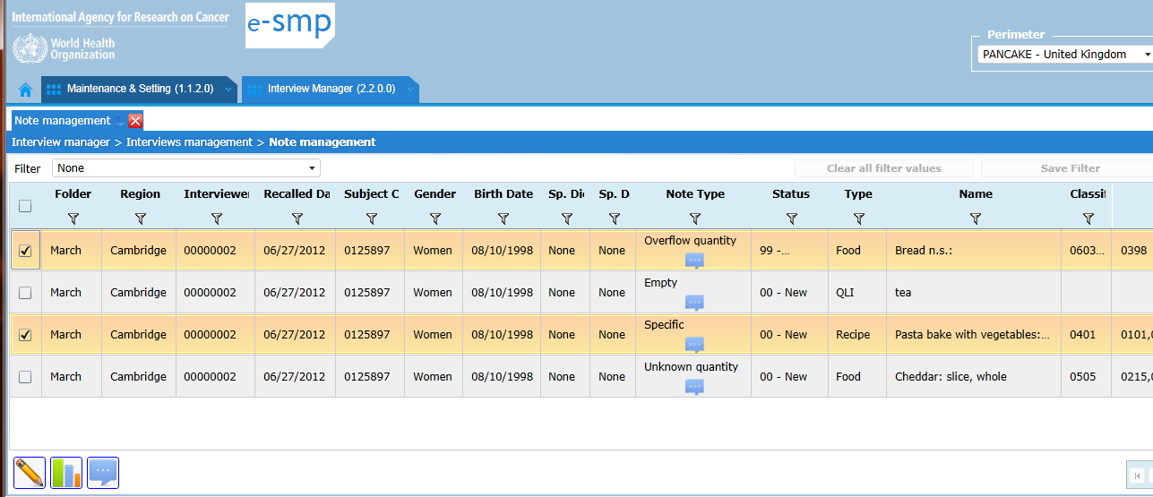
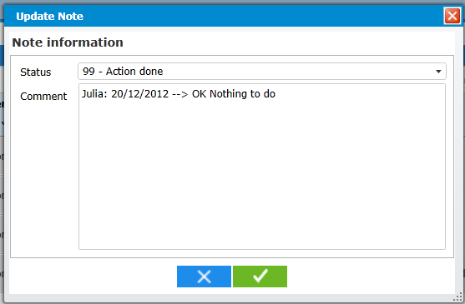
Note Management: Update
2
Updating several notes at the same time
Change Status
Added comments
Technical IT issues
IARC, Lyon - France
GloboDiet training:

Slide 48
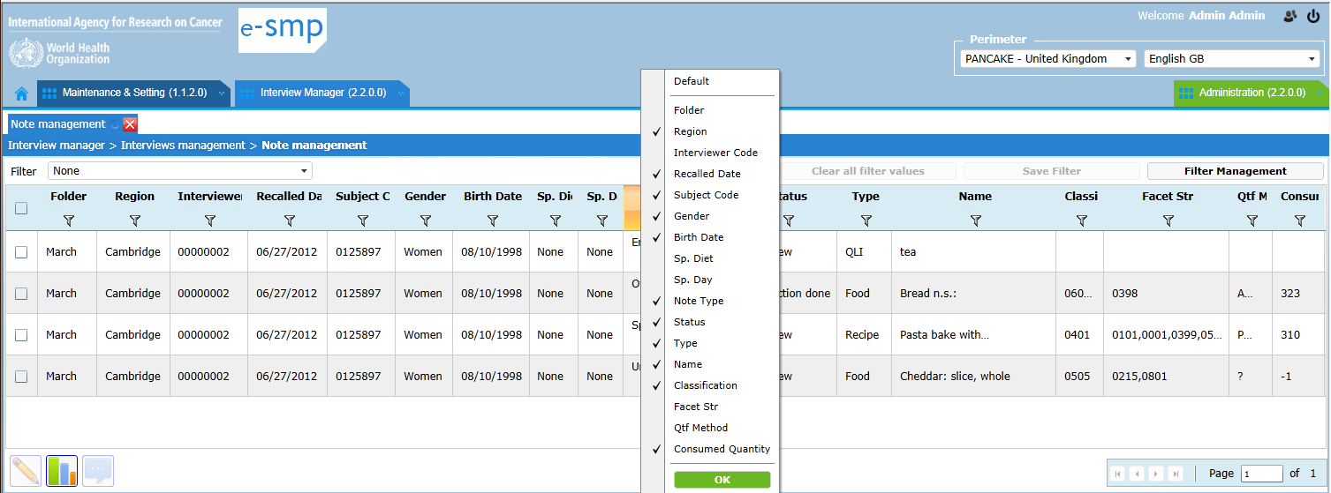
Note Management: Column selection
2
Displaying only selected columns
3. Default to display all
1. Click on the right mouse button, cursor on the column headband
2. Deselect the unnecessary columns
Technical IT issues
IARC, Lyon - France
GloboDiet training:

Slide 49
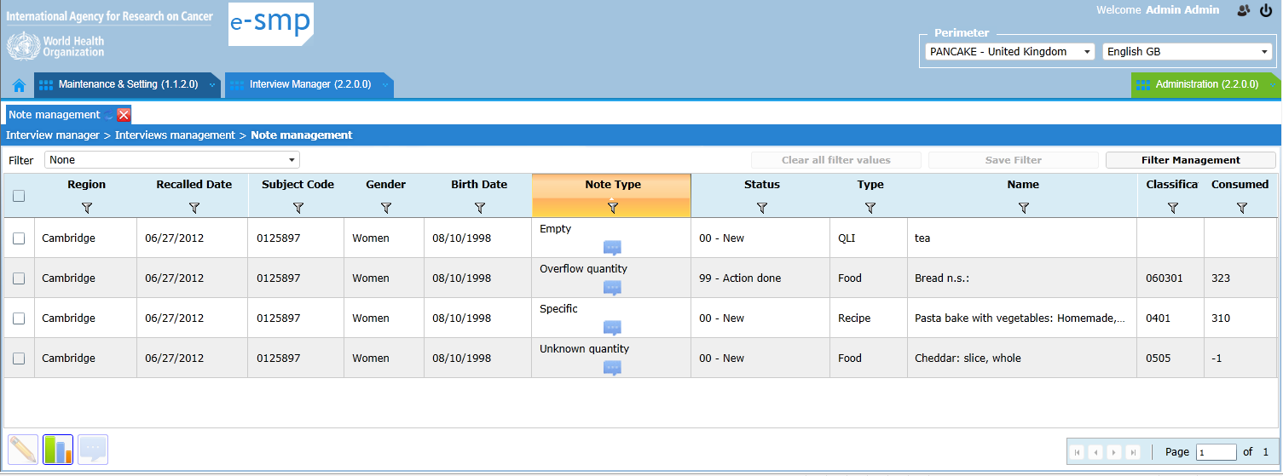
Note Management: Column selection
2
Displaying only selected columns
Displayed result
Technical IT issues
IARC, Lyon - France
GloboDiet training:

Slide 50
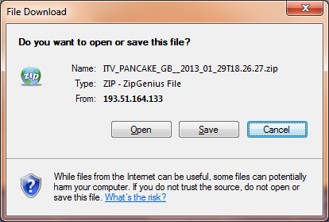
Note Management: Export
1. Export for statistical analyses
2. Indicate where to save the generated zip-files that contains CSV- & XML-files
→ See guidelines: Export data from IMapp describing the provided file contents
GloboDiet training:
IARC, Lyon - France

Slide 51
Interview Manager Menu
2
VIEW / EXPORT
Technical IT issues
IARC, Lyon - France
GloboDiet training:
Notes:
From here we can switch to the software demonstration

Slide 52
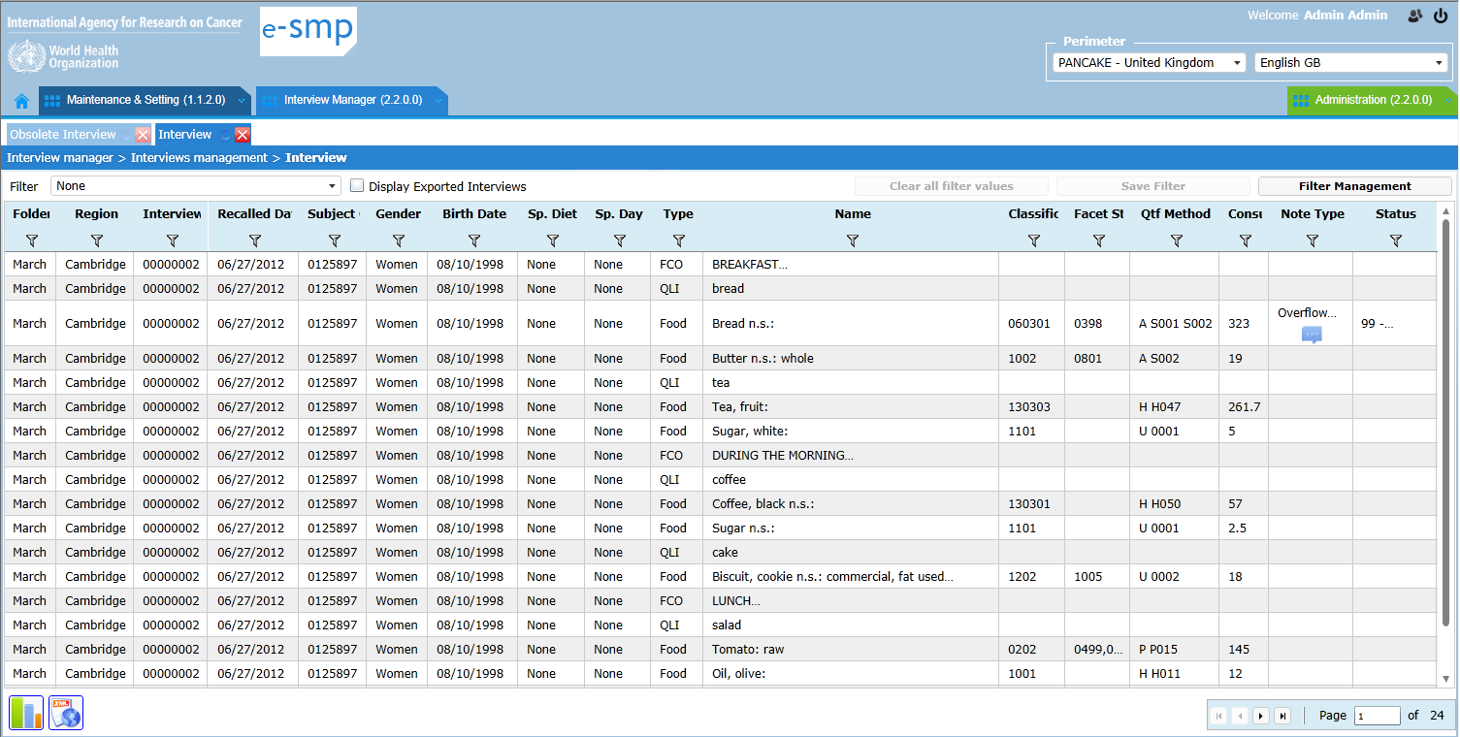
Displaying & Exporting Interviews
2
To see the details of all the items reported during the interviews
Technical IT issues
IARC, Lyon - France
GloboDiet training:

Slide 53

Displaying & Exporting Interviews
2
Allocated Functions:
  Filter, available in each column to refine the search
    → Possibility to save a defined filter, to open an existing one, to manage the available ones and to clear all
  Export for statistical analyses, the selected interviews in csv- and XML-files. → See Export function in Note screen (slide 50)
  Export for update: the selected interviews that need to be updated with GloboDiet (XML-files). This file can be dowloaded using the “Download” function in the menu.
  Note: These exported interviews are no longer visible on the platform until they are re-imported (after update with GloboDiet).
  → Export for update function should be used carefully.
GloboDiet training:
IARC, Lyon - France
Technical IT issues

Slide 54
Displaying & Exporting Interviews
2
Export for update with EPIC-Soft:
  Only interviews that needs to be updated should be exported by using the Select functions, for example subject selection by ID code and/or regarding the Note Status (“to be updated”, “on-going”…). Use the Filter functionalities to facilitate the selection.
  These exported interviews are then not visible on the platform (in Note and View/Edit screesn) until they will be re-imported (after update with GloboDiet).
  This export function should be used carefully
GloboDiet training:
IARC, Lyon - France
Technical IT issues

Slide 55

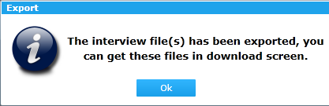
Displaying & Exporting Interviews
2
3. Export confirmation.
4. You have to go to Download menu under Interview Manager tab
1. Filter selection (e.g. 1 subject)
2. Export for update function
Technical IT issues
IARC, Lyon - France
GloboDiet training:

Slide 56
Interview Manager Menu
2
DOWNLOAD
Technical IT issues
IARC, Lyon - France
GloboDiet training:
Notes:
From here we can switch to the software demonstration

Slide 57
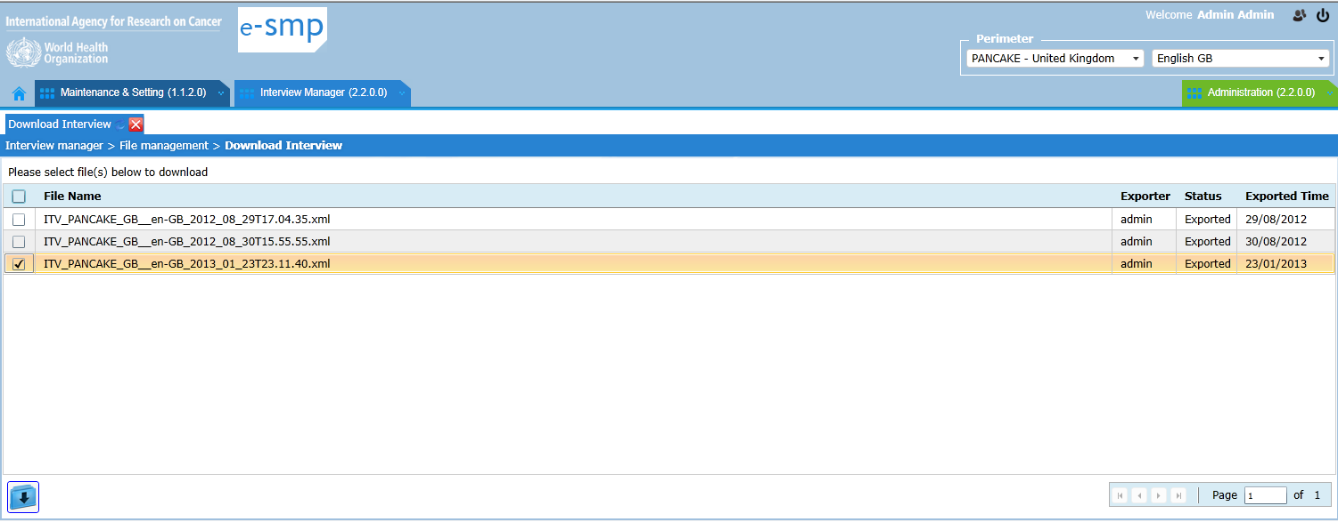
Download of Exported Interviews
2
Download of exported interview files (XML-files)
1. File selection
2. Download button. A prompt to specify the folder (on your PC) where to download the file will follow.
Technical IT issues
IARC, Lyon - France
GloboDiet training:

Slide 58
Interview Manager Menu
2
OBSOLETE INTERVIEWS
Technical IT issues
IARC, Lyon - France
GloboDiet training:
Notes:
From here we can switch to the software demonstration

Slide 59
Obsolete Interviews
2
When an interview is exported for update (in GloboDiet), it becomes unvisible in IMapp, but it is there.
When this interview is imported again (after update in GloboDiet), a higher version number is given to it (e.g. version 2 is given for 2nd import). We can have several versions of the original interview (version 1) to the last up-to-date one.
On Obsolete Interviews screen, we can see all the previous versions of interviews (from version 1 to version n-1).
Possibility to delete previous version of interviews except version 1 that corresponds to the “raw” interview.
Possibility to restore a previous interview version and the last up-to-date one will be deleted !
Technical IT issues
IARC, Lyon - France
GloboDiet training:

Slide 60
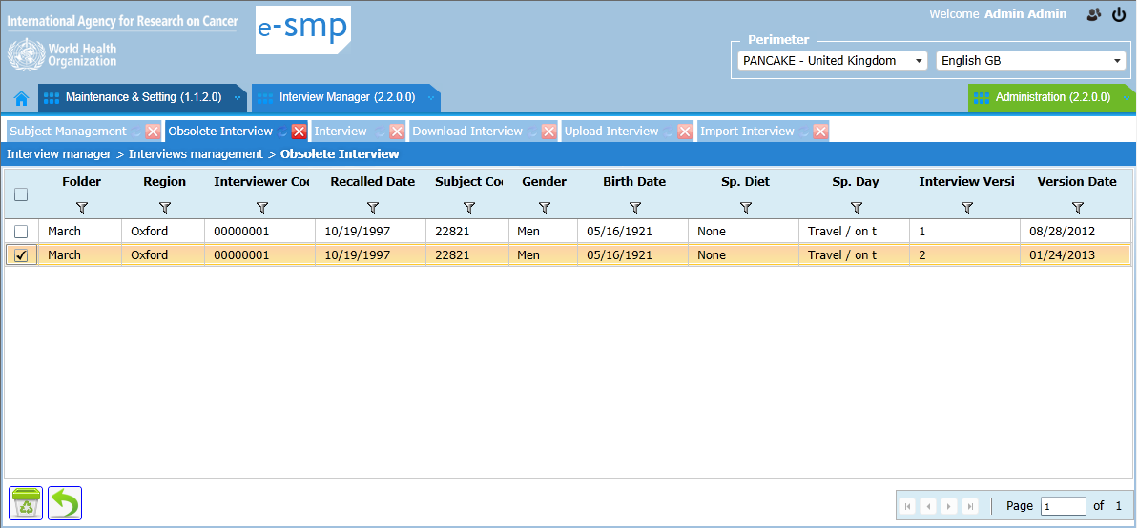
Obsolete Interviews
2
Delete selected interview versions
For this subject, 2 previous interview versions exist. The one displayed in View/export menu will have the last version ( version 3)
In case of a problem, you can Restore to a previous version of an interview. In this example, the interview with version 3 will be replaced by version 2
Technical IT issues
IARC, Lyon - France
GloboDiet training:

Slide 61
Dataflow between GloboDiet & IM
Information to be added in GloboDiet database
(ex: new foods, recipes…)
IMapp
2’
Administration
2
2
1
Preparation of
GloboDiet Tables
Interviews/Notes
(raw/updated data)
3
4
Interviews/Notes
(to be updated)
Data Export for statistical analyses
Technical IT issues
IARC, Lyon - France
EPIC-Soft training:
Globo Diet Application

